Slide 1
Ghidra-LLM: Large Language Models for Static Reverse Engineering
Week 10 Update
Project 9: Bisesh, Mack, Maximilan, Craig, Justin

Slide 2
Review - Project Goal
In this project, our team will create large language model support for NSA’s new reverse engineering tool, Ghidra.
Reverse engineering is inherently a lossy process. Valuable context and data is often lost or obscured. Our goal is to use machine learning to bridge this gap.

Slide 3
Review – Project Process
Multi-step project that consists of numerous phases
Phase 1: Research & Red Teaming current LLM application (Current)
Phase 2: Improving current models (Late Fall – Early Spring)
Phase 3: Further refinement & integrating our new model into Ghidra (Spring)

Slide 4
Review – Phase 1
We are taking advantage of a current existing open-source large language model "LLM4Decompile".
This LLM already has the ability to decompile binary/assembly to C (Best version ~65% accurate)
Our current goal is to refine this LLM to become more accurate.
How do we accomplish this?

Slide 5
Team Objectives
Our team has the latest LLM4Decompile model running on our development environment
Hosting this model on ubuntu desktop provided by GMU, with code repository (github) https://github.com/SPIRE-GMU/SPIRE_GLLeN/tree/dev
With the model running, we can begin to test, improve, and refine it.
We have split into 2 teams to achieve these objectives
RAG Team – This team oversees building a RAG Pipeline that we will combine with LLM4Decompile to improve accuracy
Red Team – This team oversees evaluating the current LLM4Decompile model and determining where it falls short.

Slide 6
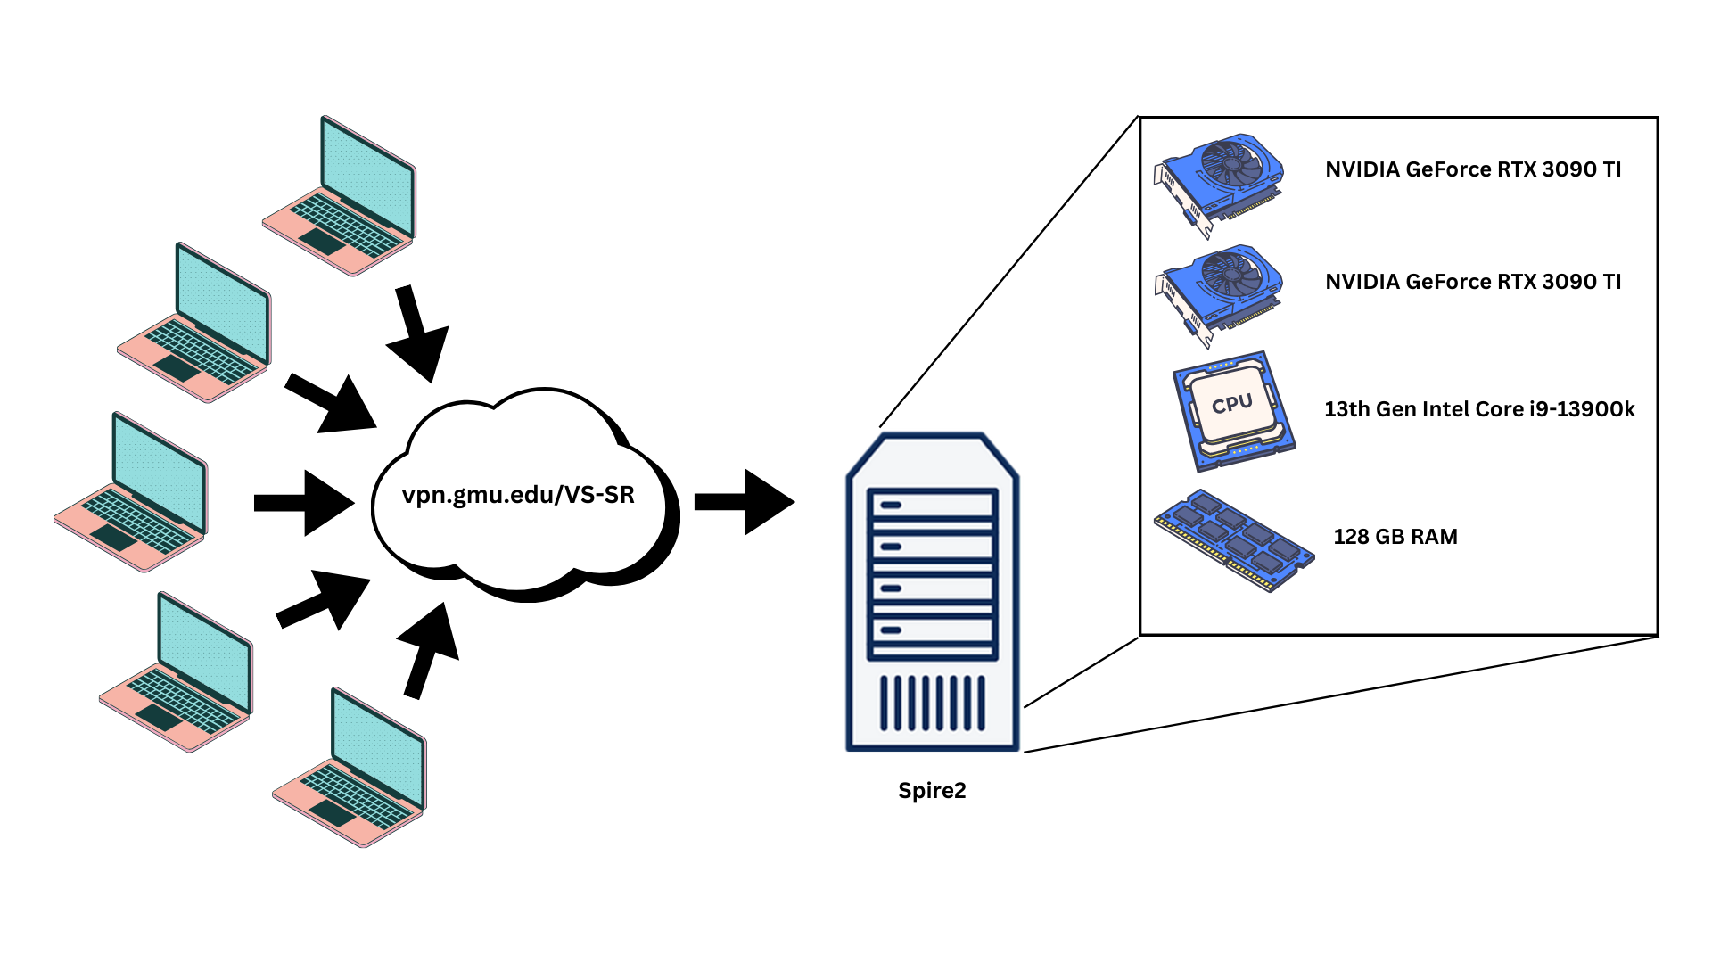
Lab Environment

Slide 7
Red Team (Mack, Max, Bisesh) Objectives – Last 2 weeks
Created an automated script to test functions within exeBench for criteria:
Re-compile-ability
Executability
Human Readable
Gathered 1,000 working files and 5,000 failed files for use in red team efforts.
Began to sort failed files into categories to use in red team package tests.

Slide 8
Red Team (Mack, Max, Bisesh) Objectives – Next 2 weeks
Begin studying attacks and create a plan for where to begin.
Sort through dataset to determine why each failed file failed
Execute plan for testing packages defined by supplied documents

Slide 9
RAG Team (Craig, Justin) Objectives – Last 2 Weeks
Created a local subset of exeBench data using successful and unsuccessful files
Began working on creating a local database of C and ASM files to be used as RAG input.
Efforts paused due to more recent given directions
Utilized neo4j and GenAI tools to vectorize exeBench subset
Created vectorization process
Created Control Flow Graph mappings of C -> ASM
Successfully built relationship map
Began stripping layers of LLM4Decompile to refine the input.
LLM4Decompile is built using Deepseek Code and LLAMA2
Established local model of DeepSeek Coder to understand "chat" functionality

Slide 10
RAG Team (Craig, Justin) Objectives – Next 2 Weeks
Create a better CFG Map by refining input functions to get better relationships
Research GCC and Radar 2 as replacements for Ghidra in CFG creation tools
Create new input layers for LLM4Decompile that accepts multiple parameters (Files, Text, CFGs)
Use ChatGPT or Deepseek coder to better create an indexed database of assembled functions

Slide 11
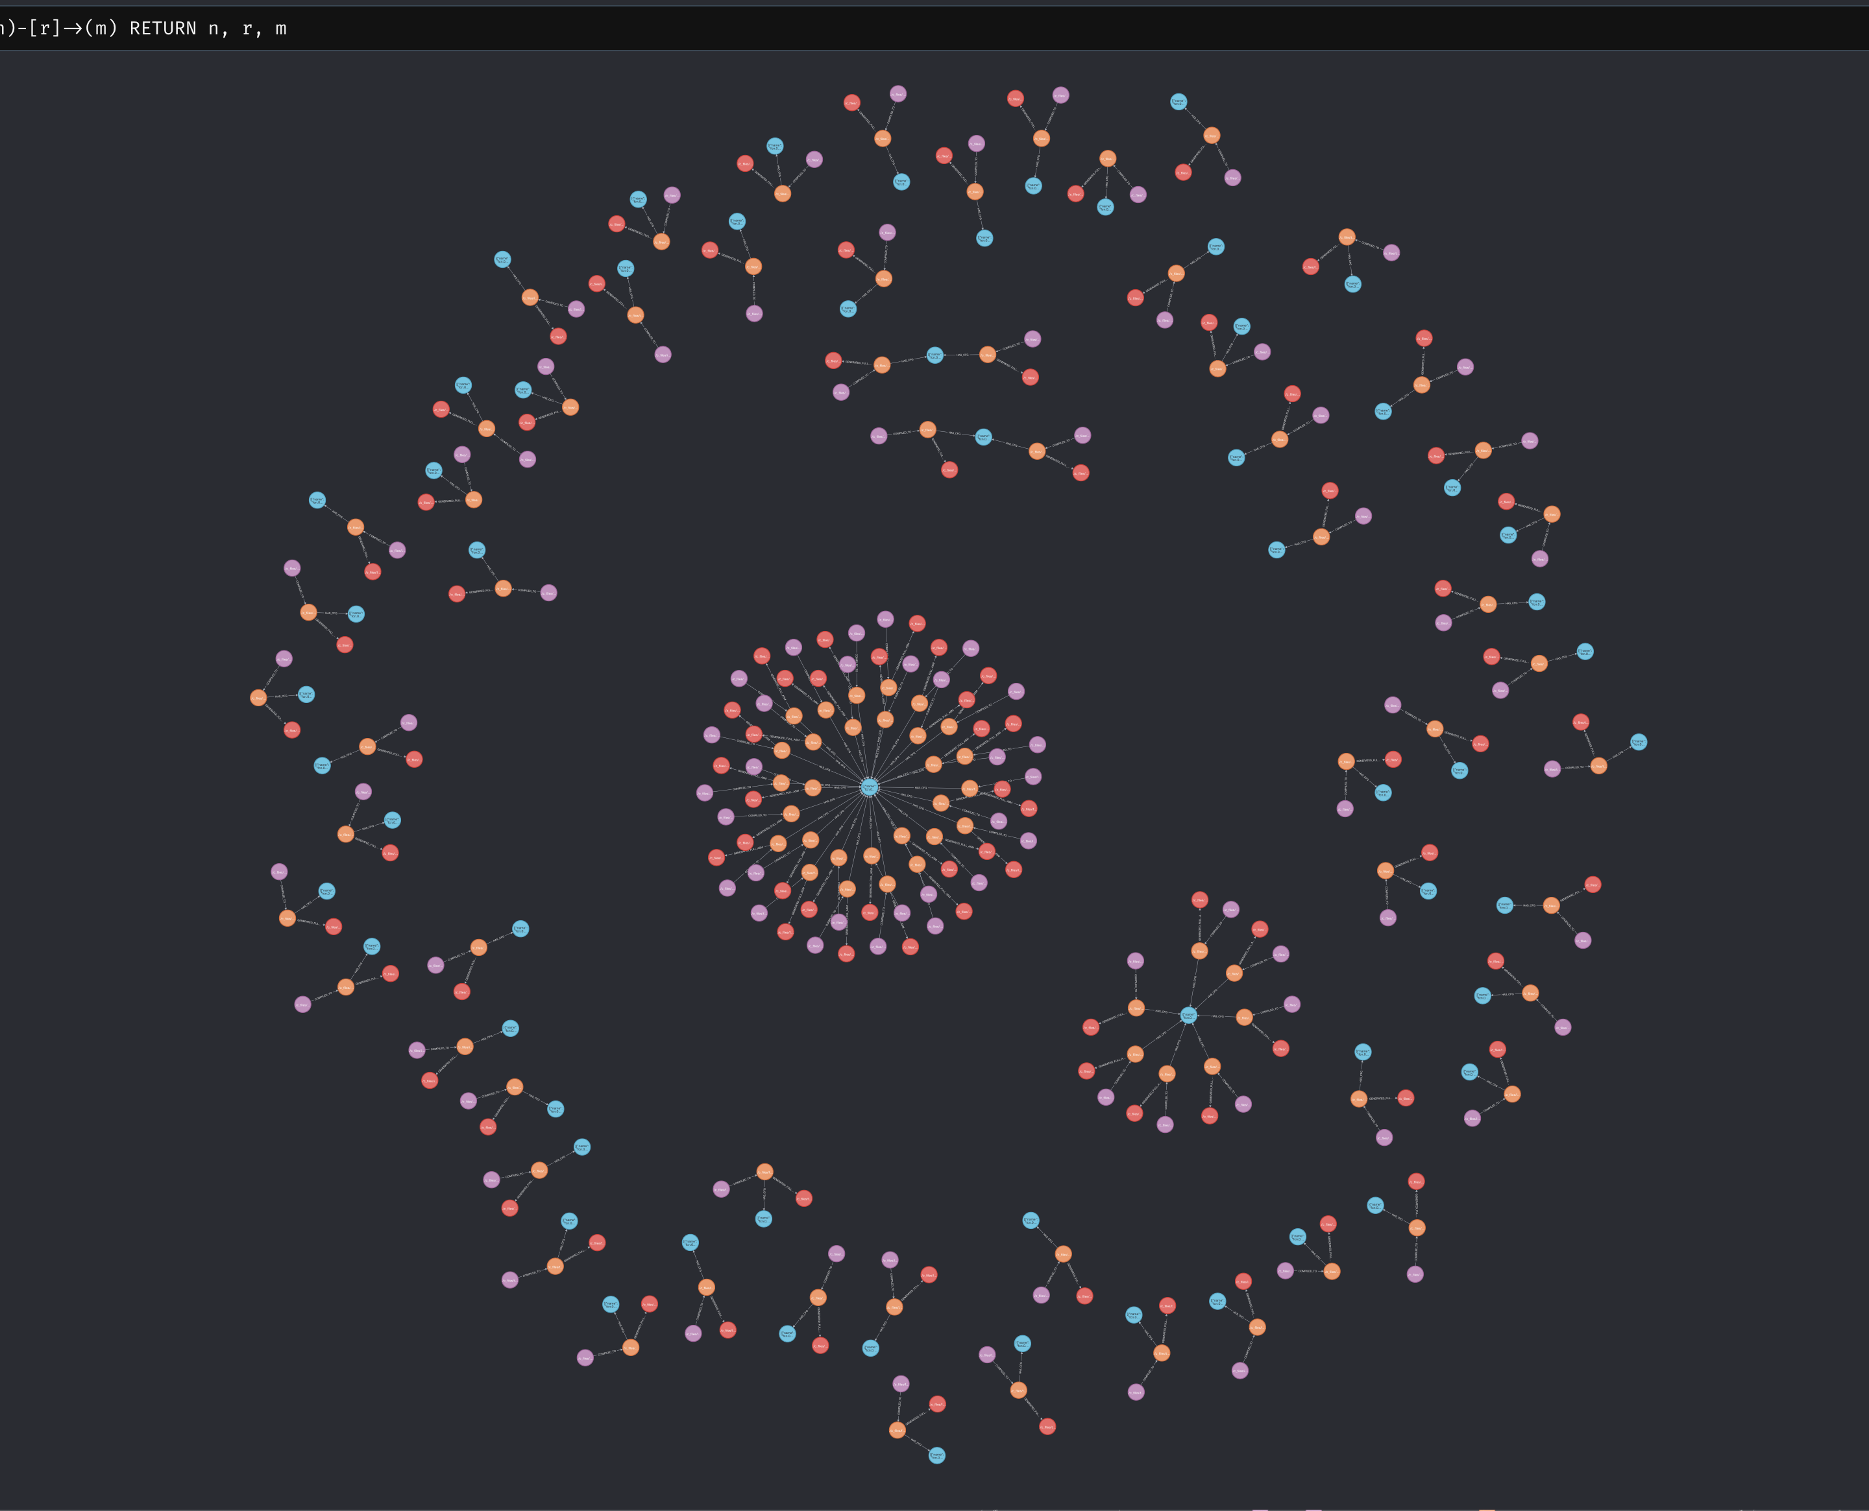
CFG Map

Slide 12
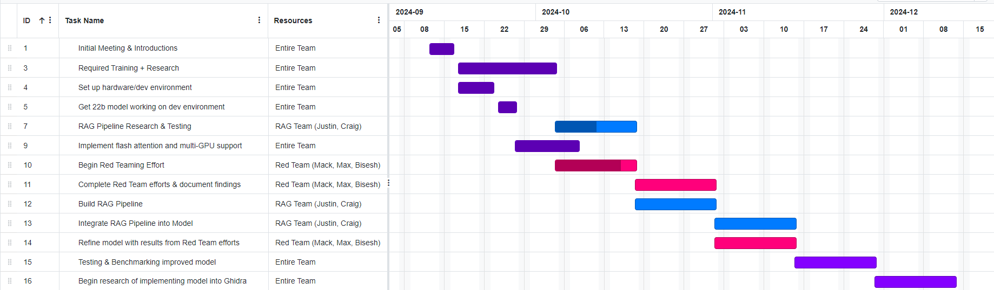
Gantt Chart – Phase 1

